Slide 1
GeoCoin
Bringing GIS & GeoTechnologies to the Blockchain
Researching and Exploring NFTs

Slide 2
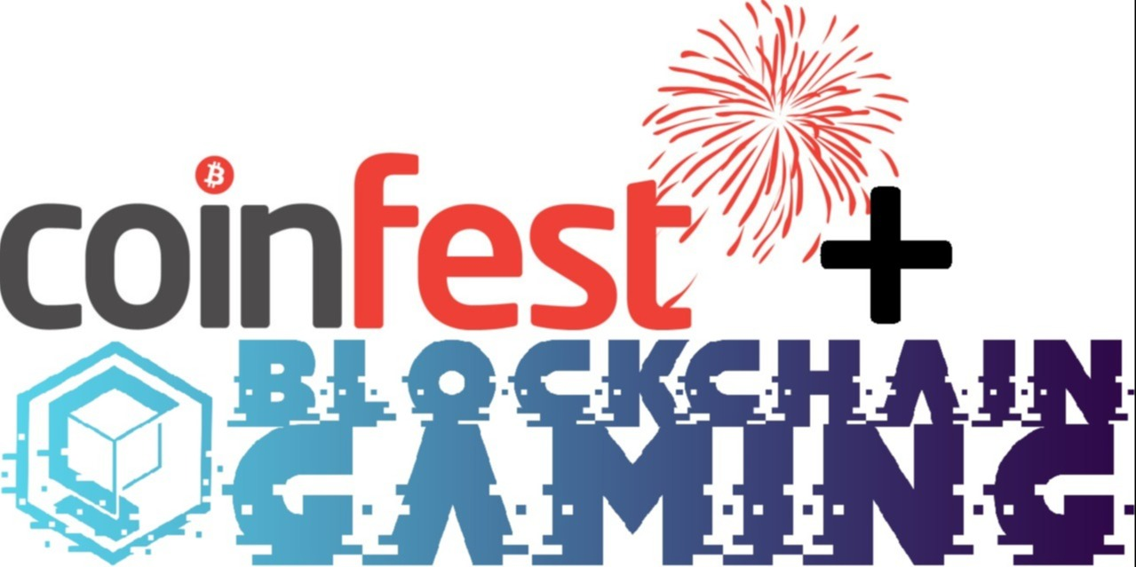
Thanks to the Organizers and Attendees
CoinFest
Blockchain Gaming
Crypto Valley Convention Center
All our guests and attendees

Slide 3
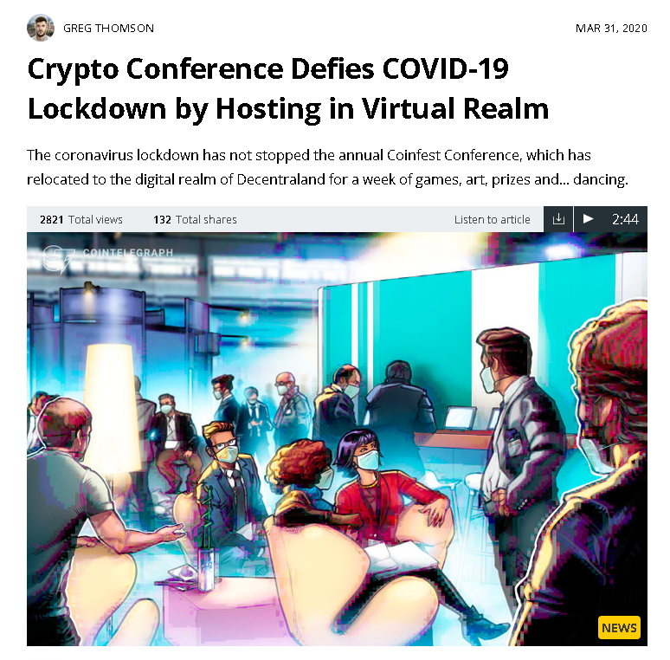
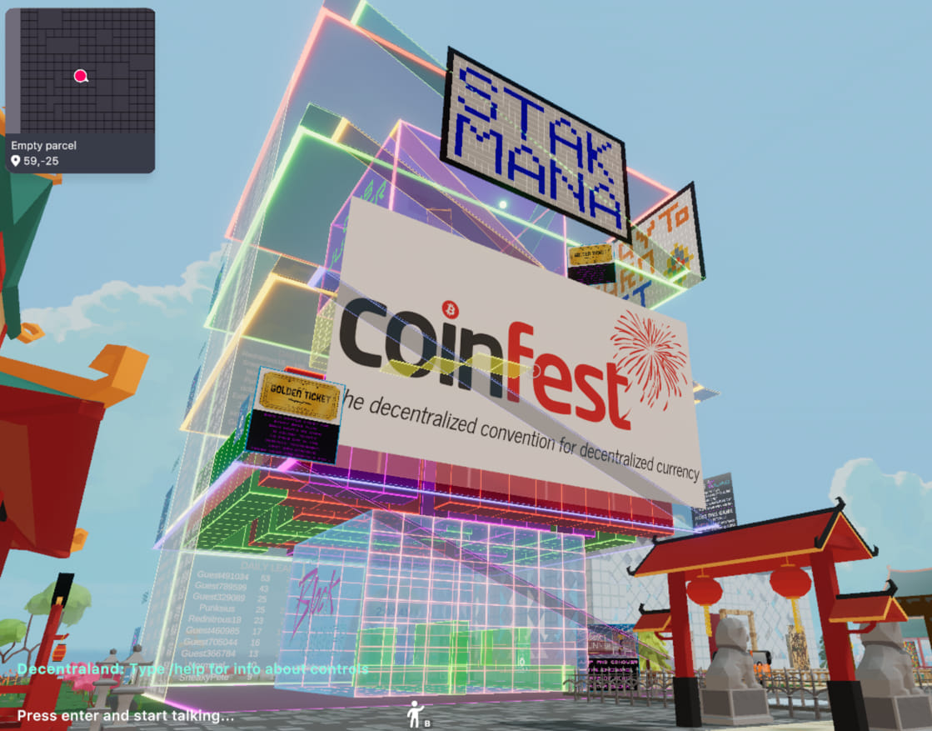
2nd Crypto Event Held in the DCL Metaverse
CoinFest April 2020 Event
MetaZone
Decentraland Conference Center
GeoCoin Scavenger Hunt

Slide 4
About GeoCoin
GeoCoin creates a real world scavenger hunt rewarded in cryptocurrency
Proof of Location (PoL): Users can ‘mine’ GEO by logging in, turning on their smartphone GPS and navigating to the location of the nearest GEO on the map
Hosted on the Ubiq network, secured by unique PoW mining algorithm Ubqhash
Ubqhash reduces the risk of 51% rental attacks

Slide 5
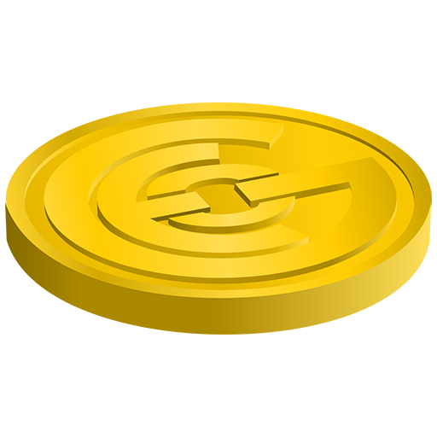
GeoCollectible NFTs
Currently researching ERC 721 and 1155 tokens for NFTs
Just in the initial stages
OpenSea ERC 721 tutorial
Learning how to configure NFT metadata, mint tokens

Slide 7
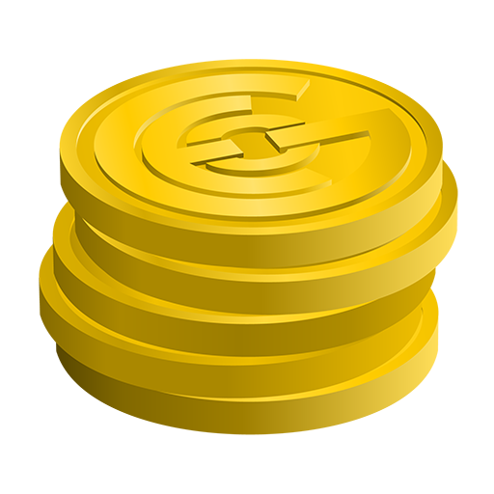
GeoCollectible NFTs
NFT tokens that represent Collectible Art (Artist: TunaChum)
Provide on chain ownership and transferability
Goal is to include these NFTs within the GEO Drops
Develop a redemption process to claim the NFT

Slide 9
Elemental GeoCollectibles
Elemental GEO: coins that can only be found in certain environments
Earth, Water, Air, Fire and more

Slide 10
GeoHunter Achievements and Statistics
Similar to many fitness apps and sport trackers
Earn NFT Tokens marking important milestones
Collecting / Dropping GEO (10, 50, 100, 1000)
Tokens for holidays and special events
Earning X Amount of GEO / Day
Adds to the gaming aspects and can increase competitiveness amongst userbase
Rewarded with onchain collectibles that can be transferred or sold

Slide 11
NFTs with in app functionality

Slide 12
NFT Infrastructure
Major platforms such as OpenSea and Enjin are currently only available on Ethereum
NFT Store is currently being developed for Ubiq
10grans ($GRANS) Developer Moon
Ability to buy or sell NFTs using a range of Ubiq network tokens, or mint new NFTs
No technical skills required!

Slide 13
Block Explorer Support
Ubiqexplorer.com Version 3, developed by Erik
Features rich lists (UBQ and all tokens), better token tracking and excel data exports
Powered by Azure, Dot Net Core, Cosmos DB, C
Ubiqscan.io, new version of spectrum developed by Angellox
Adding ERC 721 and 1155 support

Slide 15
New Exchange for GeoCoin, Shinobi DEX
Ubiq developers have recently launched a new DEX called Shinobi
Powered by the Uniswap V2 smart contracts
Creates an AMM swap site allowing any developers to setup pairs and liquidity pools for their token
Reduces barriers of entry, no longer dependent on CEX listing fees
Encourage any new blockchain gaming projects that are looking to deploy to consider launching on the Ubiq Network
There is also the Augmentum Incubator Program designed to help projects migrate and launch on Ubiq, to find out more be sure to join the Ubiq Community Discord

Slide 18
GeoCollectible NFTs
NFTs seem to be the latest craze in the blockchain space
Very excited to be researching and integrating NFTs into GeoCoin
Provide on chain Collectible Art, Elemental GEO, GeoHunter Achievements and Statistics, Potential for future in app NFT functionality and more
Excited to learn from other projects in the blockchain gaming space and how they are utilizing NFTs within their dapps

Slide 19
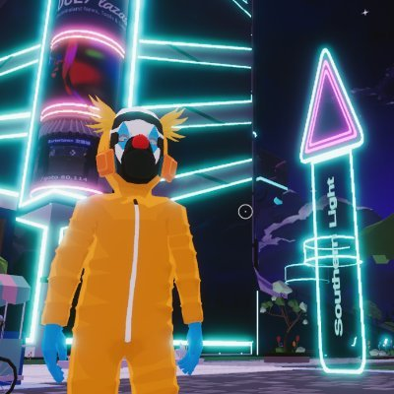
Shoutout to Cryptanthropy
Since the last CoinFest event, community member Aaron decided to start building the Cryptanthropy Headquarters within the Decentraland Metaverse
Cryptanthropy uses crypto donations to provide Random Acts of Kindness to people in need all around the world
Learn about Ubiq and GeoCoin
Check out some cool art from artist TunaChum
Listen to music, dance or even watch movies!

Slide 20
To check out Cryptanthropy type /goto 23, -123

